Slide 1

Total pension 2024
Source: Total pension in Finland 2024
How are earnings-related pensions, national pensions and taxation determined?
Suvi Ritola and Samuli Tuominen
Finnish Centre for Pensions, Reports 03/2024.
Report and data: https://urn.fi/URN:NBN:fi-fe202402167597

Slide 2
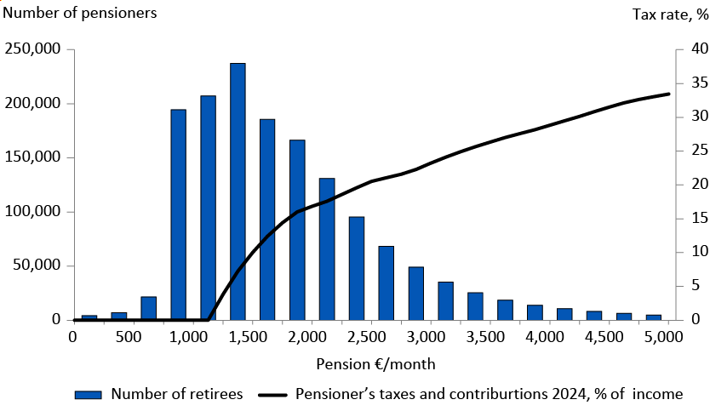
Pension income distribution for pension recipients residing in Finland in their own right (excluding part-time pension and partial old-age pension) at 31 December 2022, and pensioner’s tax and contribution rate in 2024

Slide 3
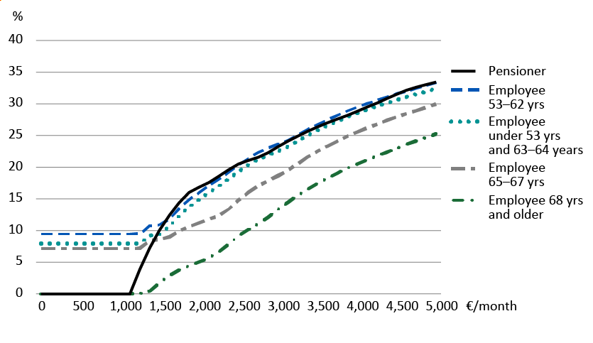
Employee’s and pensioner’s taxes and contributions in 2024 (% of income; monthly income is annual income divided by 12)

Slide 4
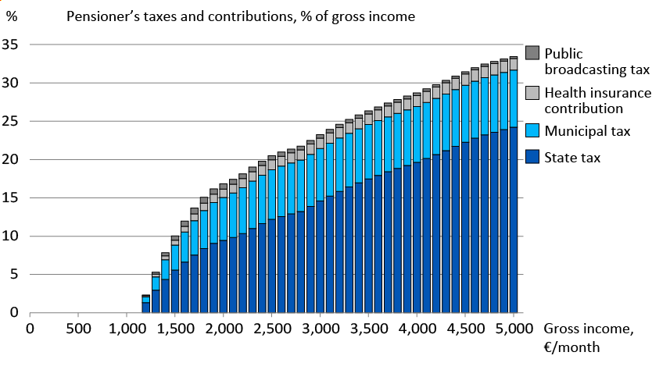
Structure of pensioner’s and employee’s (53–62 yrs) taxes and contributions in different income brackets in 2024 (% of gross income)

Slide 5
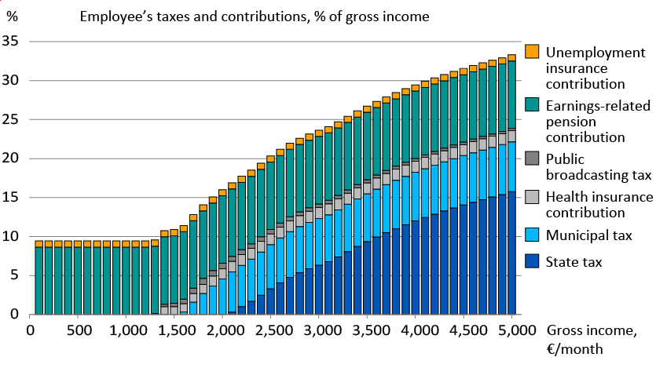
Structure of pensioner’s and employee’s (53–62 yrs) taxes and contributions in different income brackets in 2024 (% of gross income)

Slide 6
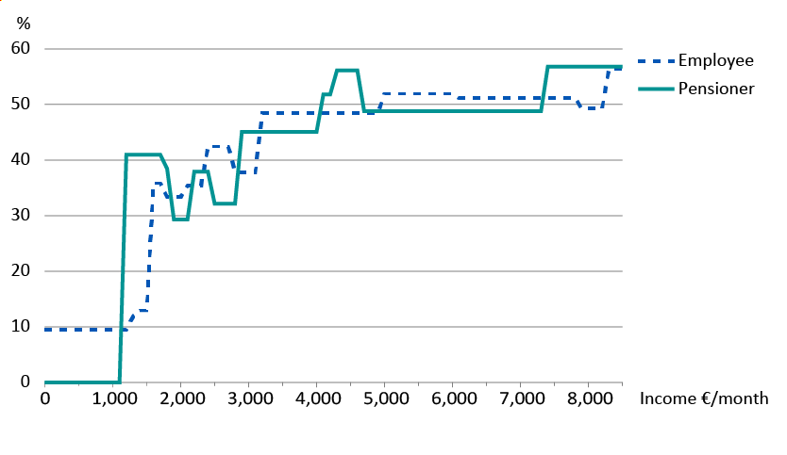
Pensioner’s and employee’s (53–62 yrs) marginal tax rate in 2024 in different income brackets

Slide 7
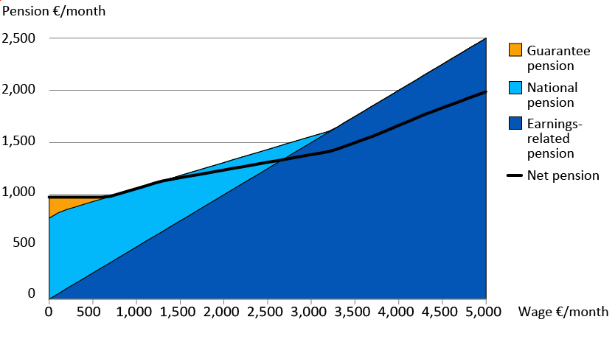
Total pension income in 2024

Slide 8
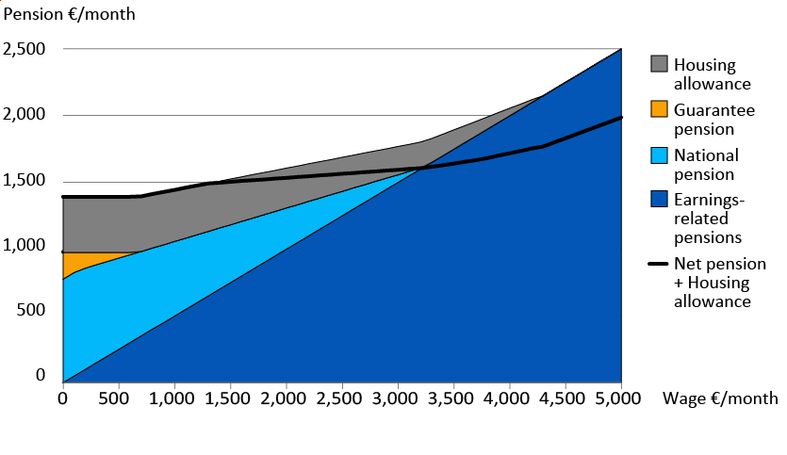
Earnings-related pension, national pension, guarantee pension and housing allowance in 2024

Slide 9
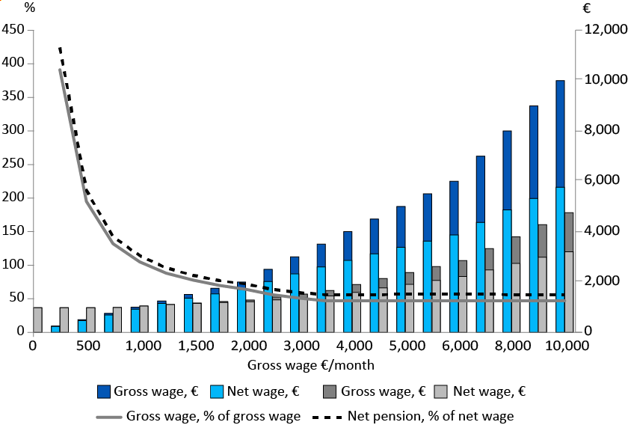
Gross and net pension, amount €/month and % of wage

Slide 10
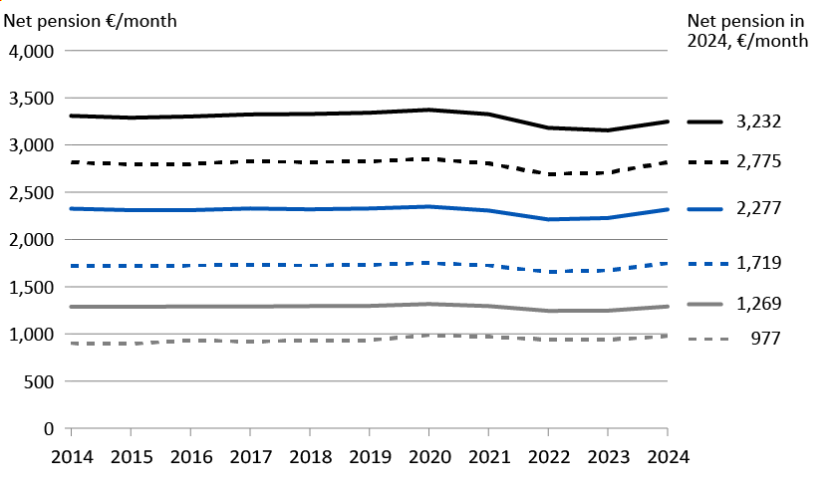
Net pension income in 2014–2024, at 2024 prices

